Slide 1
PVT Simulator PE251_V10
By Mansoor Hussain
Dedicated to Raphael Babar who will one day beat Raphael Nadal
30-November-2020

Slide 2
Contents:
Summary
What’s New (Nov 2020)
Technical Background
Features/Functions
Step By Step Guide for Oil
Step By Step Guide for Gas

Slide 3
SUMMARY
I have developed a PVT Simulator; which can be used if a Commercial Simulator is not available to the User.
The Programme has been written in Python and is very straight forward to use and produces Output which after minor editing can be used with the Eclipse Simulator.
The results have been compared to Commercial PVT package and fall within the Error Margin (prior to any Tuning)

Slide 4
What’s New ? (November 2020)
Oils
1. Simulate Differential Liberation Experiments (DL_func) and compare to Observations
2. Produce Black Oil Tables PVTO and PVDG based on Differential Liberation (blackoil3_func)
Gas Condensates
1. Simulate Constant Volume Depletion (CVD_func) and compare to Observations
2. Produce Black Oil Tables PVTG (Gas_Cond_func1) and PVTO (Gas_Cond_func2)
Separators
Separator Function has been added, where one can simulate as many stages as necessary (Sep_func)
Saturation Pressure
Added a Function to output Saturation Pressure (Sat_Pres_func)
Phase_func
Generates Two Phase Function

Slide 5
What’s New ? (November 2020)
Facility to modify Pc and Tc of highest fraction (or any other component) to Tune the results.
#---------------
# Tuning
# Specify highest Fraction
#---------------
Pc['C10']=Pc['C10']*1.0
Tc['C10']=Tc['C10']*1.0

Slide 6
Technical Background
Uses Peng Robinson (2-Parameter) Equation of State and Flash Equation to determine, the Liquid and Vapour Mole Fractions and Compositions and Volumes
Uses Lohrenz Bray Clark to determine Viscosity (Does not Psudoize C7+)
The Simulator is written in Python and can be executed on Jupyter Notebook OR in batch mode using the Python Command

Slide 7
Features:
Input:
i) Composition of the Reservoir Fluid in Mole Fraction (Up to C16)
ii) Reservoir Temperature (Degree F)
iii) List of Pressures for which Experiment needs to be conducted
iv) Separator Pressure and Temperature ( Two Stages are allowed)
2. Output:
Oil:
Rs, Bo, viscosity vs Pressure for Oil
Bg, viscosity vs Pressure for Gas
PVTO and PVDG Tables (in Excel Format)
Composition of Oil and Gas at Separator (and all intermediate stages)
Gas Condensates:
Rv, Bg, Viscosity vs Pressure for Gas
Rs, Bo, Viscosity vs Pressure (Saturated Only)
PVTG and PVTO (Saturated values only) (in Excel Format)
Composition of Oil and Gas at Separator (and all intermediate stages)
3. All Plots can be viewed in Jupyter Notebook

Slide 8
Major Functions

Slide 9
Workflow
This function is at the heart of the simulator and is called by various other functions
x,y,L,V,zeta_l,zeta_v, liq_v, vap_v=workflow(P, T_F, z)
Input: Pressure (psia), Temperature(Deg. F), Composition (mole fraction)
Output: liquid composition, vapour composition,
liquid mole fraction, vapour mole fraction,
Z-factor Liquid, Z-Factor Vapour,
liquid volume (ft3), vapour volume (ft3)
check_sum_func(z)
This function checks if the sum of the input composition =1.0 (within tolerance)
Sat_Pres=Sat_Pres_func (P_Max, P_Min, T_F, z)
Input: Guess values for Maximum and Minimum Saturation Pressure, Temperature,
Composition (mole fraction)
Output: Saturation Pressure

Slide 10
Phase_func
This function returns 2-Phase Envelope:
list_T, list_Sat_Pres=Phase_func(P_Max,P_Min,T_Max,T_Min,z)
Input: The Pressure Range to be searched for Two Phase Envelope,
The Temperature Range to be searched for Two Phase Envelope
Caution:
Can take a few minutes to run

Slide 11
Separator
Simulates Separtors
(list_x,list_y,list_liq_moles,list_vap_moles,liq_vol,vap_vol)=sep_func(P_sep_list, T_sep_list, z)
Input: List of Pressures (psia) at successive Stages, List of Temperatures (Deg.F) at successive stages, Input Composition
Output: liquid mole fraction, vapour mole fraction, vap_moles, liq_moles, liquid volume (ft3), vapour volume (ft3)
Vap volume (ft3), vap moles
Z
Liquid volume (ft3), liquid moles
Liquid from each stage is assumed to flow to next stage
Vapour from each stage is assumed to join the vapour stream

Slide 12


Differential Liberation
Simulates Differential Liberation Experiment
P_Diff, v_over_vres,v_gas_over_vres,list_L1= DL_func(P_Diff, T_res,z)
Input: List of Pressures (psia) in Descending Order, Reservoir Temperature (Deg.F), Raw Fluid Composition
Output: vo/vores, vg/vgres
Observed
Simulated
In this instance, the results are being compared to Commercial Simulator

Slide 13
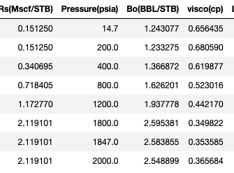
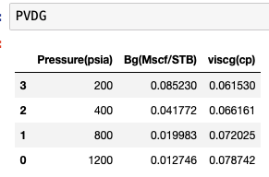
Black Oil Function
Bo,Rs,Visco, L1, Bg,viscg, P_Gas= blackoil_func (z, T_F, P_Diff,P_Sep_list,T_Sep_list):
Input: Differential Pressure descending order (psia), Separator Pressure, Separator Temperature,
Reservoir Temp(Degree F), Separator Pressure (for each stage, Separator Temperature (for each stage)
Output: PVTO and PVDG Tables
PVTO
Remember to modify it to comply with Eclipse Format

Slide 14
Constant Volume Depletion
Bo,Rs,Visco, L1, Bg,viscg, P_Gas= Gas_Cond_func1(P_CVD, T_res, z):
Input: CVD Pressures descending order (psia), Reservoir Temp(Degree F), composition
Output: CVD Observations: Oil Saturation and Moles Recovered
Observed
Simulated

Slide 15
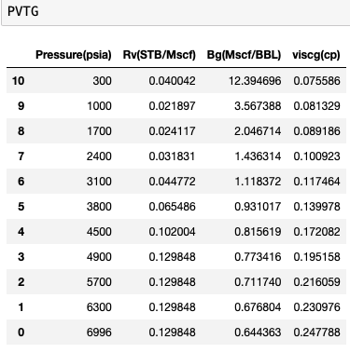
Gas Condensate 1
Bo,Rs,Visco, L1, Bg,viscg, P_Gas= Gas_Cond_func1(P_CVD, T_res, z
Input: CVD Pressures descending order (psia), Reservoir Temp(Degree F), composition
Output: PVTG Table
Remember to modify it to comply with Eclipse Requirements
Saturated row missing for highest pressure

Slide 16
Gas Condensate 1
Bo,Rs,Visco, L1, Bg,viscg, P_Gas= Gas_Cond_func1(P_CVD, T_res, z
Input: CVD Pressures descending order (psia), Reservoir Temp(Degree F), composition
Output: PVTG Table
Observed
Simulated

Slide 17
Gas Condensate 1
Bo,Rs,Visco, L1, Bg,viscg, P_Gas= Gas_Cond_func1(P_CVD, T_res, z
Input: CVD Pressures descending order (psia), Reservoir Temp(Degree F), composition
Output: PVTG Table
Remember to modify it to comply with Eclipse Requirements

Slide 18
Gas Condensate 2
(list_P,list_Rs,list_Bo,list_visco,list_P_us,list_Bo_us,list_visco_us)=(P_CVD,T_res,z)
Input: CVD Pressures (psia) in Descending Order, Reservoir Temperature (Deg. F), Composition
Output: PVTO for Condensate

Slide 19
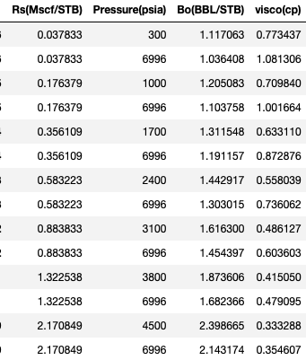
Gas Condensate 2
(list_P,list_Rs,list_Bo,list_visco,list_P_us,list_Bo_us,list_visco_us)=(P_CVD,T_res,z)
Input: CVD Pressures (psia) in Descending Order, Reservoir Temperature (Deg. F), Composition
Output: PVTO for Condensate
Remember to comply it to Eclipse Format

Slide 20
Step by Step Guide:

Slide 21
User Input Oil or Gas
User is required to provide:
Reservoir Fluid Composition in Mole Fractions: (User must ensure they add up to 1.0)
Reservoir Temperature in Degree Fahrenheit
List of Reservoir Pressures (P_Diff or P_CVD) in psia in (Descending Order)
Fluid Type i.e. Oil or Gas
List of Separator Pressures, List of Separator Temperatures
Pressure and Temperature of Each Separator Stage:

Slide 22
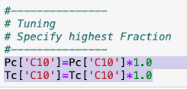
Steps for OIL
1. Execute DL_func(): Compare the results to Observed Data:
2. Optional(Modify Pc,Tc of the heaviest component)
Execute BlackOil_func():
This will Generate PVTO and PVDG
(remember to add slashes and remove the repeated saturated Rs values to comply with Eclipse Format)

Slide 23
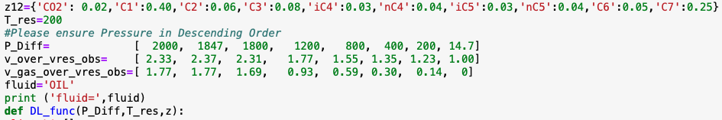
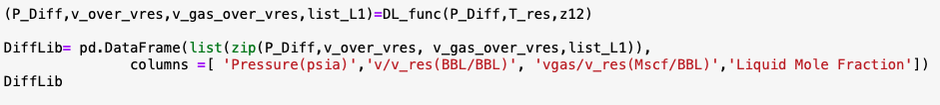
Example OIL: Execute DL_func Differential Liberation Function
Observed Data for Comparison
Input can be at the top of the code or just above the function Statement

Slide 24
Differential Liberation
Simulates Differential Liberation Experiment
P_Diff, v_over_vres,v_gas_over_vres,list_L1= DL_func(P_Diff, T_res,z)
Input: List of Pressures (psia) in Descending Order, Reservoir Temperature (Deg.F), Raw Fluid Composition
Output: vo/vores, vg/vgres
Observed
Simulated
In this instance, the results are being compared to Commercial Simulator

Slide 25
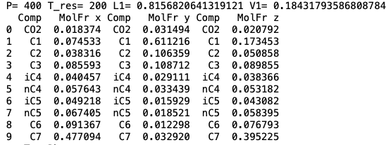
Differential Liberation: Sample Output (text)
Liquid and Vapour Composition at each stage

Slide 26
Example OIL: Execute blackoil_func()
Simulates Differential Liberation Experiment
P_Diff, v_over_vres,v_gas_over_vres,list_L1= blackoil_func(P_Diff, T_res,z)
Input: Differential Pressure descending order (psia), Separator Pressure, Separator Temperature,
Reservoir Temp(Degree F), Separator Pressure (for each stage, Separator Temperature (for each stage)
Output: PVTO and PVDG Tables
Remember to modify it to comply with Eclipse Format

Slide 27
Step by Step Guide: GAS

Slide 28
Steps for Gas
1. Execute CVD_func(): Compare the results to Observed Data:
2. Optional(Modify Pc,Tc of the heaviest component)
Execute Gas_Cond_func1():
This will Generate PVTG and PVTO
(remember to add slashes and remove the repeated saturated Rs values to comply with Eclipse Format)

Slide 29
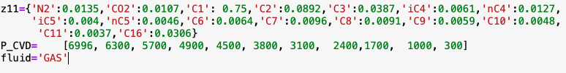
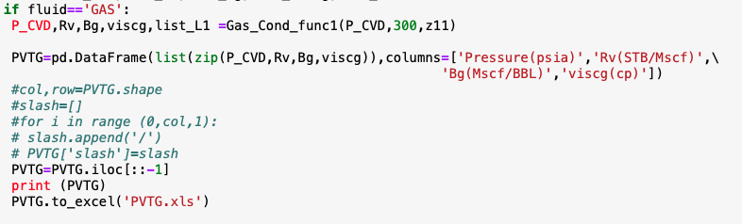
Example: Gas
Execute CVD_func() Constant Volume Depletion Experiment
Input can be at the top of the code or just above the function Statement

Slide 30
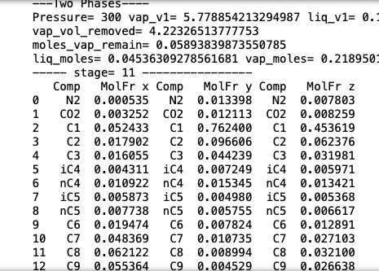
Constant Volume Depletion:
Sample Output (text)
Liquid and Vapour Composition at each stage

Slide 31
Constant Volume Depletion
Bo,Rs,Visco, L1, Bg,viscg, P_Gas= Gas_Cond_func1(P_CVD, T_res, z):
Input: CVD Pressures descending order (psia), Reservoir Temp(Degree F), composition
Output: CVD Observations: Oil Saturation and Moles Recovered
Observed
Simulated

Slide 32
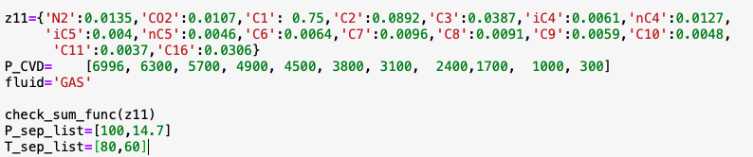
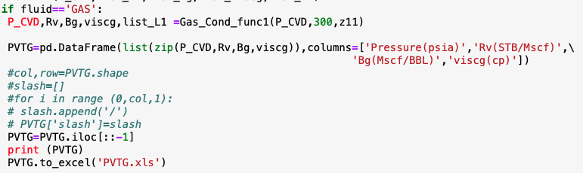
Example: Gas Execute Gas_Cond_func1()
Input
Execution

Slide 33
Gas Condensate 1
Bo,Rs,Visco, L1, Bg,viscg, P_Gas= Gas_Cond_func1(P_CVD, T_res, z
Input: CVD Pressures descending order (psia), Reservoir Temp(Degree F), composition
Output: PVTG Table
Observed
Simulated

Slide 34
Gas Condensate 1
Bo,Rs,Visco, L1, Bg,viscg, P_Gas= Gas_Cond_func1(P_CVD, T_res, z
Input: CVD Pressures descending order (psia), Reservoir Temp(Degree F), composition
Output: PVTG Table
Remember to modify it to comply with Eclipse Requirements

Slide 35
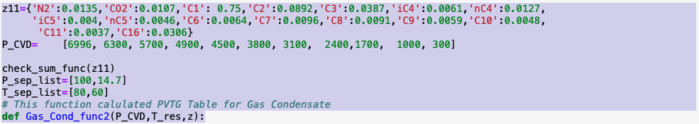
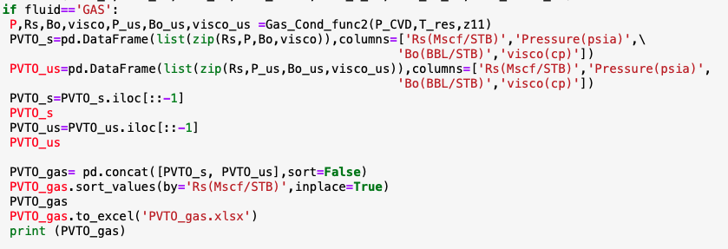
Example: Gas Execute Gas_Cond_func2()
Input
Execution

Slide 36
Gas Condensate 2
(list_P,list_Rs,list_Bo,list_visco,list_P_us,list_Bo_us,list_visco_us)=(P_CVD,T_res,z)
Input: CVD Pressures (psia) in Descending Order, Reservoir Temperature (Deg. F), Composition
Output: PVTO for Condensate

Slide 37
Gas Condensate 2
(list_P,list_Rs,list_Bo,list_visco,list_P_us,list_Bo_us,list_visco_us)=(P_CVD,T_res,z)
Input: CVD Pressures (psia) in Descending Order, Reservoir Temperature (Deg. F), Composition
Output: PVTO for Condensate
Remember to comply it to Eclipse Format

Slide 38
Future Work as of Nov 2020
In the Upcoming Versions:
Include Corresponding States Model (PEDERSEN) for Viscosity Calculation (Work In Progress)
Develop the ability to produce more than one Undersaturated Lines.
Develop the ability to calculate First Contact Miscibility Pressure (FCMP)
Develop the ability to calculate Multiple Contact Miscibility Pressures MCMP and Ternary Diagrams
Develop the ability to carry out REGRESSION on Pc and Tc of the Heaviest Fraction to match the Experimental Data

